Slide 2
learn the basic concept URL and URLConnection Class
understand the various methods of URL and URLConnection Class
implementation of URL and URLConnection Class

Slide 3
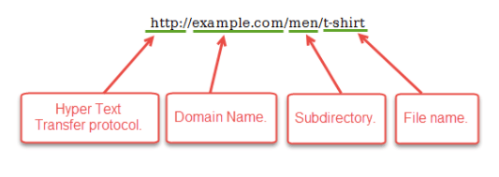
URL
URL is a string of text that identifies all the resources on Internet, telling us the address of the resource, how to communicate with it and retrieve something from it.
A Simple URL looks like:

Slide 4
URL Class
The URL class is the gateway to any of the resource available on the internet.
A Class URL represents a Uniform Resource Locator, which is a pointer to a “resource” on the World Wide Web.
A resource can point to a simple file or directory, or it can refer to a more complicated object .
The URL class in java is built in the java.net.URL package of java.

Slide 5
Constructors of URL class
URL(String address) throws MalformedURLException
URL(String protocol, String host, String file)
URL(String protocol, String host, int port, String file)

Slide 6
Constructors of URL class
URL(URL context, String spec)
URL(String protocol, String host, int port, String file, URLStreamHandler handler)
URL(URL context, String spec, URLStreamHandler handler)

Slide 7
Methods of URL Class
public String getProtocol()
public String getHost()
public String getPort()
public String getFile()

Slide 8
Methods of URL Class
public String getAuthority()
public String toString()
public String getQuery()
public String getDefaultPort()

Slide 9
Methods of URL Class
public String getPath()
publicboolean equals(Object obj)
public Object getContent()
public String getRef()

Slide 10
URLConnection Class
The URLConnection class represents a communication link between the URL and the application.
It can be used to read and write data to the specified resource referred by the URL.

Slide 11
URLConnection Class
There are mainly two subclass that extends the URLConnection class-
HttpURLConnection
JarURLConnection

Slide 12
Features of URLConnection class
URLConnection is an abstract class.
With the help of URLConnection class, a user can read and write to and from any resource referenced by an URL object.
Once a connection is established and the Java program has an URLConnection object, we can use it to read or write or get further information.

Slide 13
Methods of URLConnection Class
URLConnection openConnection()
Object getContent()
Map<String,List> getHeaderFields()
getContentEncoding()

Slide 14
Methods of URLConnection Class
getContentLength()
getDate()
getHeaderField(int i)
getHeaderField(String field)

Slide 15
Methods of URLConnection Class
OutputStream getOutputStream()
InputStream getInputStream()
setAllowUserInteraction(boolean)

Slide 16
Methods of URLConnection Class
setDefaultUseCaches(boolean)
setDoInput(boolean)
setDoOutput(boolean)

